Slide 1
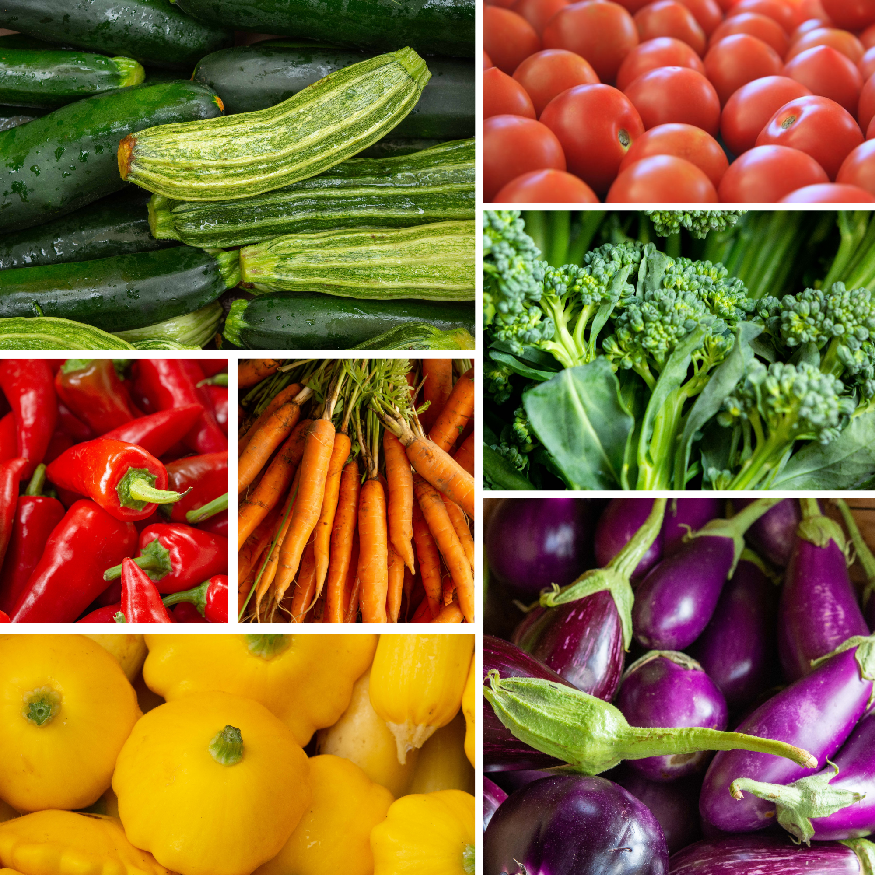
Field to fork: the food we eat
Michele Fronk Schuckel, MBA, BSN, Certified Master Gardener
Natural Selections Gardens
michele@NaturalSelectionsGardens.com
©Natural Selections Gardens 2021

Slide 2
What a Price LookUp Code reveals:
CONVENTIONALLY-GROWN FRUIT:
four-digit numbers run through all the fruits
guava is 4299
banana is 4011
ORGANICALLY-GROWN FRUIT:
five-digit labels that start with the number 9
Organically-grown banana 94011
GENETICALLY MODIFIED FOOD:
five-digit labels start with an 8
Genetically engineered vine ripe tomato would be 84805.
©Natural Selections Gardens 2021

Slide 3
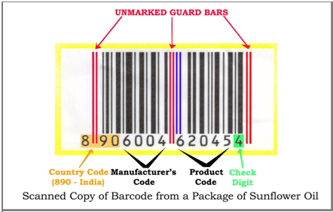
Decode the Code
AUSTRALIA: 93
USA & CANADA: 00-13
FRANCE: 30-37
GERMANY: 40-44
JAPAN: 49
UK: 50
DENMARK: 57
FINLAND: 64
SWITZERLAND & LIECHTENSTEIN: 76
SAUDI-ARABIAN: 628
UNITED ARAB EMIRATES: 629
CENTRAL AMERICA: 740-745
PHILIPPINES: All 480 codes
©Natural Selections Gardens 2021
Notes:
Let’s first talk about the origin.
When you look at the barcode on your foods, be sure to take note of the first 2-3 digits. This tells you where your food has come from.
AUSTRALIA: 93
USA & CANADA: 00-13
FRANCE: 30-37
GERMANY: 40-44
JAPAN: 49
UK: 50
DENMARK: 57
FINLAND: 64
SWITZERLAND & LIECHTENSTEIN: 76
SAUDI-ARABIAN: 628
UNITED ARAB EMIRATES: 629
CENTRAL AMERICA: 740-745
PHILIPPINES: All 480 codes

Slide 4
Food Insecurity:
Inability to be sure, within a household, over the course of a month about the source and availability of food for the household
©Natural Selections Gardens 2021

Slide 5
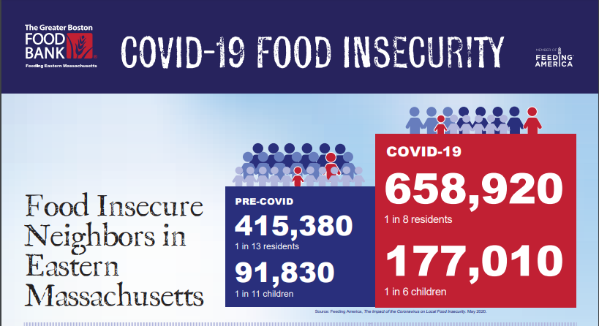

Slide 6
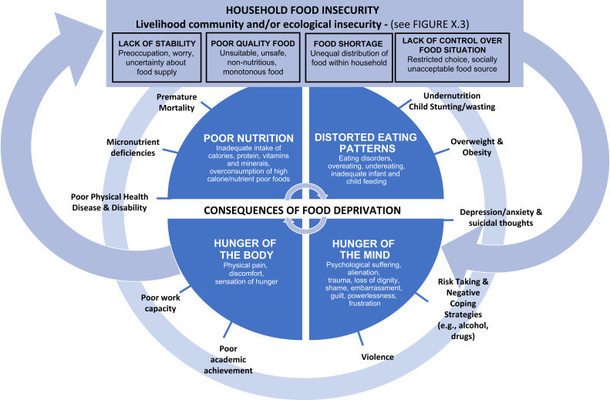
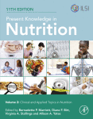
Notes:
Graphic from Chpt. 17, Present Knowledge in Nutrition (Eleventh Edition)
Volume 2: Clinical and Applied Topics in Nutrition
2020

Slide 7
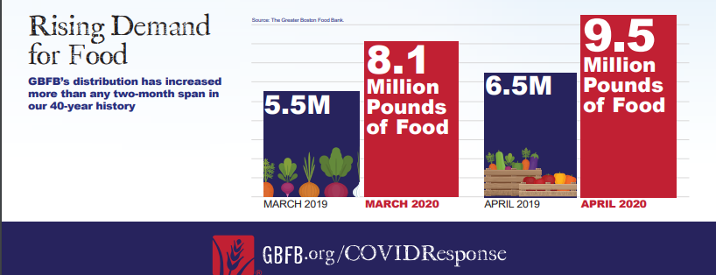

Slide 8
Using this Info at Home: Healthy Eating Tips
Select a variety of foods from a variety of sources
Buy fruits and vegetables in season when possible
Read food labels carefully
Wash and scrub fresh fruits and vegetables thoroughly under running water
Eat mindfully
Fill your plate ½ full with fruits and veggies
Plan meat-free meals
Shop with a list
©Natural Selections Gardens 2021
Notes:
Whether you go totally organic or opt to mix conventional and organic foods, be sure to keep these tips in mind:
Select a variety of foods from a variety of sources. This will give you a better mix of nutrients and reduce your likelihood of exposure to a single pesticide
Buy fruits and vegetables in season when possible. To get the freshest produce, ask your grocer what is in season or buy food from your local farmers market
Read food labels carefully. Just because a product says it's organic or contains organic ingredients doesn't necessarily mean it's a healthier alternative. Some organic products may still be high in sugar, salt, fat or calories.
Wash and scrub fresh fruits and vegetables thoroughly under running water. Washing helps remove dirt, bacteria and traces of chemicals from the surface of fruits and vegetables, but not all pesticide residues can be removed by washing. Discarding outer leaves of leafy vegetables can reduce contaminants. Peeling fruits and vegetables can remove contaminants but may also reduce nutrients.
Eat mindfully
Fill your plate ½ full with fruits and veggies
Plan meat-free meals
Shop with a list

Slide 9
7 Ways to Combat Climate Change
1. Stop wasting food
2. Cut back on meat; eat more plant-based foods
3. Drive and fly less
4. Electrify everything
5. Build up instead of out
6. Build resilience to extreme events
7. Support policy change
Notes:
1. Stop wasting food.
“Food waste accounts for around one-third of the carbon footprint of the average U.S. diet,” says Nicole Tichenor Blackstone, an assistant professor at the Friedman School whose work focuses on developing and evaluating strategies to improve food system sustainability. “This is an underestimate, because it only includes waste by households and food retailers, not loss that occurs further back in the supply chain.”
2. Cut back on meat; eat more plant-based foods.
That’s because meat—especially beef—is directly related to methane emissions, some 30 times as potent a greenhouse gas as carbon. Meat production also indirectly uses disproportionate energy, “due to the energy inefficiency of converting crops to meat calories,” says Parke Wilde, a Friedman professor who focuses on food and nutrition policy.
3. Drive and fly less.
Reducing fuel use for transport can help promote a healthy food system. “That’s because biofuels use up a large fraction of agricultural output for some major crops such as corn (maize), soybeans, and palm oil,” says Wilde. “I also strongly feel there is an important calling for university communities to pay more attention to in particular to flying less,” he adds. He’s part of flyingless.org, and a summer video project of his highlights connections between the food system and lower-carbon travel.
4. Electrify everything.
In addition to reducing food waste, eating less red meat, and driving or flying less, we can switch to more fuel-efficient equipment for everything else, says William Masters, a Friedman School professor who focuses on international development. “Big steps come from occasional decisions made every few years like where to live, what equipment to install, whether to buy a car, and if so, what kind,” he says.
“Every switch we make needs to be toward electrifying everything and getting that electricity from renewables like solar and wind power,” says Masters. “And once we’ve made that switch, we’ll no longer be in a world of scarcity where we need to do less: after the switch we can do more travel, have more heating and cooling, more of everything.”
Electricity generation and storage is a critical challenge but doesn’t undermine the feasibility of energy-system transformation to address climate change, says Wilde. “Responses include battery storage (the cost of which is plummeting), hydro storage (pumping up reservoirs when the wind is blowing and depleting them at other times), and transmission lines between cities and towns (because a larger region has a much smaller variance in average wind speed than a small region has),” he says. Those changes, plus demand side ones—such as higher pricing during times when electricity is scarce, and heavy industrial use during times when electricity is plentiful—make it doable.
5. Build up instead of out.
“The biggest step toward a zero-emissions world involves denser housing built around public transport,” says Masters. “We need to build up instead of out, and welcome new neighbors instead of hoarding the space we have. Ending exclusionary zoning can and does make new housing available near subways and along high-traffic bus routes and safe paths for cyclists. New housing in cities like greater Boston is key to zero-emissions, inclusive, and diverse communities.”
6. Build resilience to extreme events.
“We live in a changed climate, and many people are vulnerable to the increase in heatwaves, flooding, drought, fires, and combinations of these events,” says Erin Coughlan de Perez, an associate professor at the Friedman School whose work focuses on helping people adapt to climate change around the world. “We need improved early warning systems, resilient infrastructure, and smart preparedness for disasters. This affects everyone.”
7. Support policy change.
The innovations we need “depend above all on the infrastructure and regulations that only governments can provide,” says Masters. “Legislation now in Congress is truly game-changing—America’s biggest steps to address climate change of my lifetime. We must ensure that Federal and State legislation is enacted and implemented, so that individuals and businesses and universities like Tufts can do our part to save lives and protect our communities.”
“We all can help promote a sustainable food system by raising our voices in favor of climate action in political and social settings, too,” adds Wilde.

Slide 10
Learn More:
Practical Summary for Healthy Eating – Shop Like a Nutritionist
Printable Guide for Healthy, Easy Shopping
Find a Farm to Visit in Massachusetts
Rodale Institute
Good Food Institute
Mother Jones
Tufts University Friedman School
Food Politics
Organic Productions Cuts Poverty Rates, Boosts Median Household Income, Organic Trade Association
Movies:
Fed Up| The Biggest Little Farm
Reading:
The New Organic Grower by Eliot Coleman
Bringing Nature Home by Doulas Tallamy
Silent Spring by Rachel Carson
Well by Sandro Galea
Last Child in the Woods by Richard Louv
Omnivores’ Dilemma by Michael Pollan
Food Matters by Mark Bittman
Goodbye USDA, Hello Department of Well Being,
New York Times Opinion
Help Others
Greater Boston Food Bank
The Daily Table
Lovin’ Spoonfuls Food Rescue
World Health Organization
©Natural Selections Gardens 2021
Notes:
Underlined text within the slide denotes a hyperlink to the source.

Slide 11
Healthy Practices of a Home Gardener
Select & support native, companion & edible plants
Compost
Go organic
Let your grass clippings fall (& shrink your lawn!)
Mulch with your leaves
Leave some places undisturbed
Be present
Michele Fronk Schuckel
MBA, BSN, RN
Certified Master Gardener
617-417-0784
NaturalSelectionsGardens.com
©Natural Selections Gardens 2021

